Slide 1
LEARNING PARTNER -læringspartnar
A very good method to involve the pupils in their own learning, self assessment and peer assessment.

Slide 2
What’s the best way to…
-improve teaching?
FOCUS ON LEARNING!
-increase learning?
MOVE THE FOCUS OFF THE TEACHER AND ON TO THE STUDENT!
-David Kolb

Slide 3
The advantage of using LP as a method, is that the pupils
get a possibility to cooperate with others
are learning better, by communicating, explaining and discussing with each other
get TIME to reflect on the questions
are feeling more confident, because no one is alone giving their answers
are getting more active
get new, good relationships in the classroom

Slide 4
How to use LP?
The method can be used every day, in every subject, in all lessons and at all levels. At the start of a lesson, during and as a summing up at the end of a lesson
It of course has to be used together with other teaching/learning methods- it’s like all other assessment for learning and pedagogical methods; not a salvation on it’s own - VARIATION is always a key word!

Slide 5
What to think of before you to start to use the LP-method:
study your plans, and decide in what subject you want to start
explain the method to the pupils
explain the method to the parents
how to organize the classroom
how to organize/choose the pairs
how to make criteria for a good LP

Slide 6
A list of criteria for a good LP:
he/she is looking at the one who is talking
“ listening to “
“ not interrupting “
“ positive and eager to improve the LP
“ willing to discuss
“ “ cooperate
“ honest and fair
A roleplay may be useful to involve the pupils!

Slide 7
What to think about after a while:
How often should we change the LP’s?
Self assessment after the period: have I been a good LP?
Assessment of their LP.
Remind the pupils of how to behave when they get a new partner (bodylanguage a.s.o.)
Let the new LP share their self assessment: ”I’m good at...” “I will try to get better at...” Two stars and a wish?

Slide 9
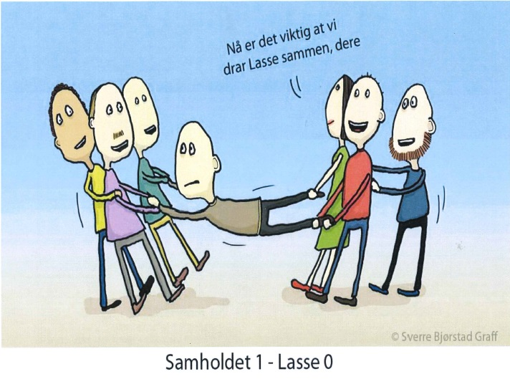

Slide 10
